Slide 1
Project Proposal
2022-2 APPLICATIONS AND PRACTICE IN NEURAL NETWORKS
Kim Jae kyoung

Slide 2
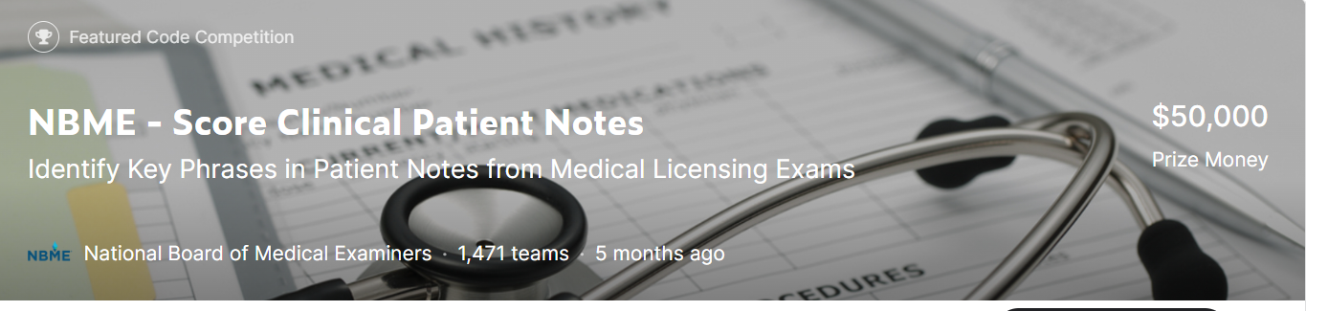
Project description
https://www.kaggle.com/competitions/nbme-score-clinical-patient-notes/overview
When you visit a doctor, how they interpret your symptoms can determine whether your diagnosis is accurate. By the time they’re licensed, physicians have had a lot of practice writing patient notes that document the history of the patient’s complaint, physical exam findings, possible diagnoses, and follow-up care.
Learning and assessing the skill of writing patient notes requires feedback from other doctors, a time-intensive process that could be improved with the addition of machine learning.
In this competition, you’ll identify specific clinical concepts in patient notes.
Specifically, you'll develop an automated method to map clinical concepts from an exam rubric (e.g., “diminished appetite”) to various ways in which these concepts are expressed in clinical patient notes written by medical students (e.g., “eating less,” “clothes fit looser”).

Slide 3
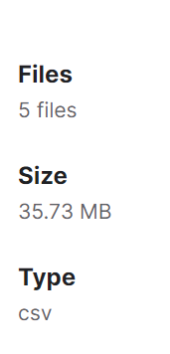
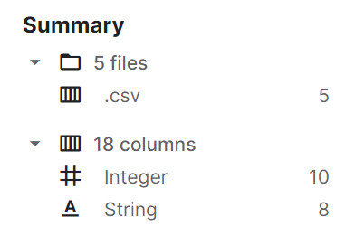
Dataset description
The text data presented here is from the USMLE® Step 2 Clinical Skills examination, a medical licensure exam. This exam measures a trainee's ability to recognize pertinent clinical facts during encounters with standardized patients.
Clinical Case: The scenario (e.g., symptoms, complaints, concerns) the Standardized Patient presents to the test taker (medical student, resident or physician). Ten clinical cases are represented in this dataset.
Patient Note: Text detailing important information related by the patient during the encounter (physical exam and interview).
Feature: A clinically relevant concept. A rubric describes the key concepts relevant to each case.

Slide 4
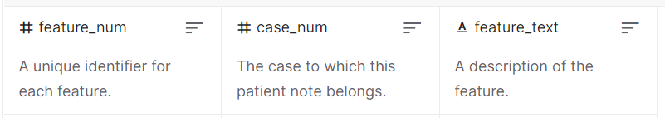
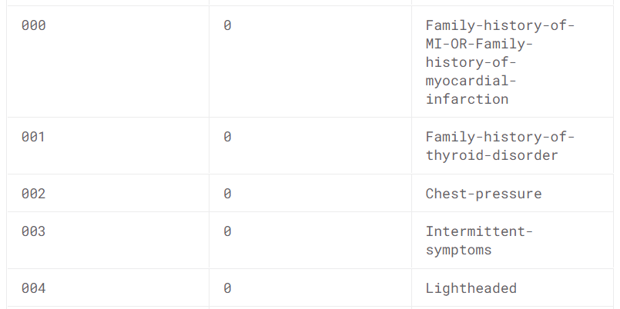
Training data
features.csv(4.35 kB)
The rubric of features (or key concepts) for each clinical case.
TEXT

Slide 5
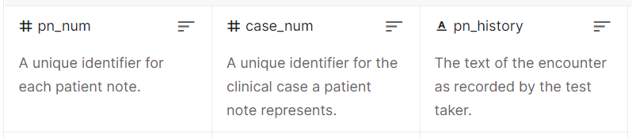
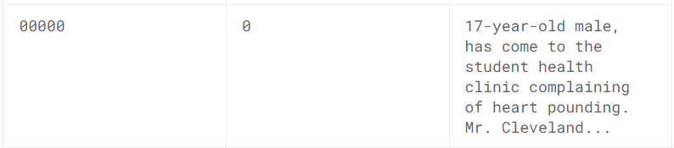
Training data
patient_notes.csv(34.97 MB)
A collection of about 40,000 Patient Note history portions.
A collection of about 40,000 Patient Note history portions. Only a subset of these have features annotated. The patient notes in the test set are not included in the public version of this file.
TEXT

Slide 6
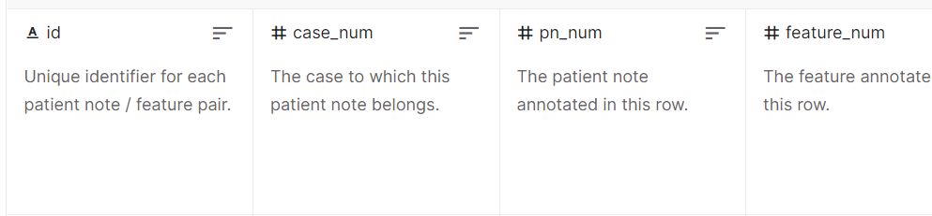
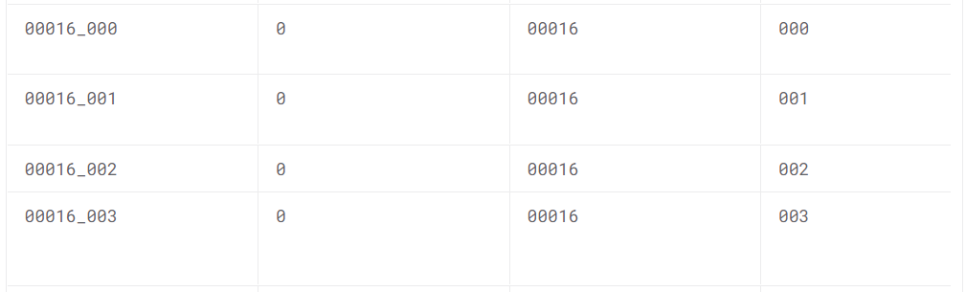
Training data
train.csv(761.25 kB)
Feature annotations for 1000 of the patient notes, 100 for each of ten cases.

Slide 7
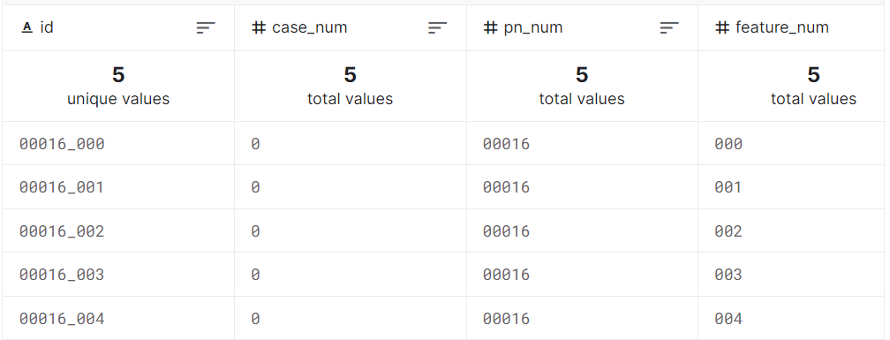
Test data
test.csv(141 B)
Example instances selected from the training set.

Slide 8
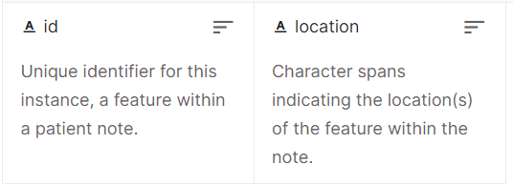
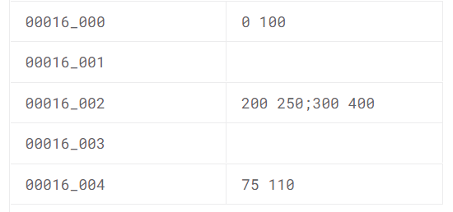
Test data
sample_submission.csv(93 B)
A sample submission file in the correct format.
TARGET

Slide 9
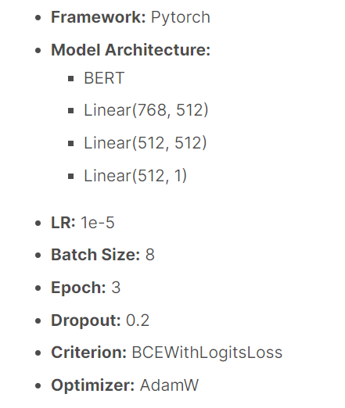
Baseline model
Pytorch Bert baseline NBME
https://www.kaggle.com/code/iamsdt/pytorch-bert-baseline-nbme
https://github.com/jaekyoungkim/-NBME-Score-clinical-patient-notes

Slide 10
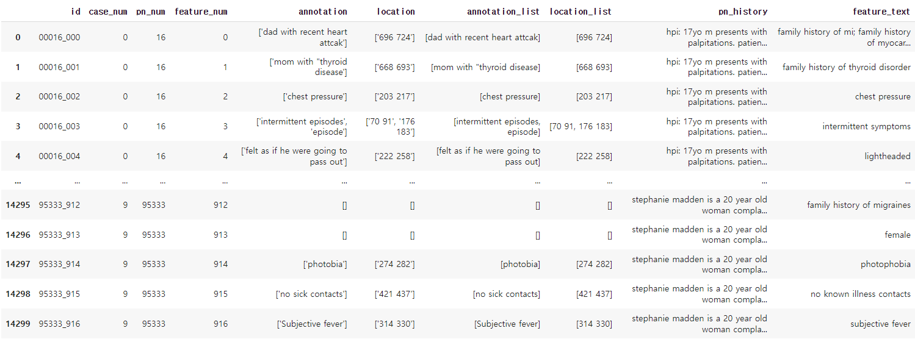
Result of baseline model
Dataset
Target
Text
Start
End
Start
End
Start
End

Slide 11
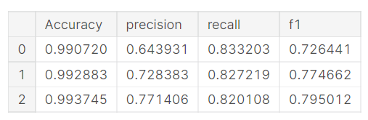
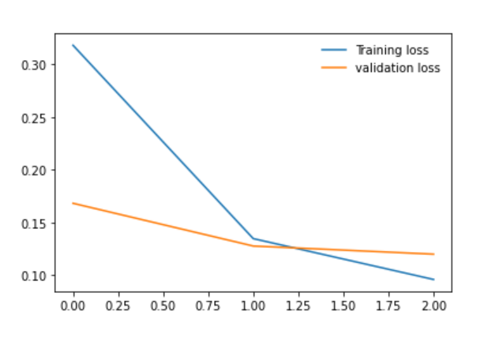
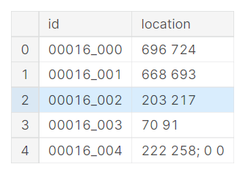
Result of baseline model
Training
Result sample

Slide 12
Contact
Email : jaekyoung88@korea.ac.kr

